Slide 1
Few important points to get model independent quadrupole deformation and triaxiality
3rd GOSIA Workshop, Warsaw 9-11 April, 2018
Julian Srebrny( Heavy Ion Laboratory, University of Warsaw)

Slide 2
Atomic nucleus is a quantum system of FINITE NUMBERS of fermions
OUTLINE
Matrix elements definitions and signs convention
Shape invariants K. Kumar-idea, D. Cline – the method development and realisation
Formulae derivation, expectation value of
quadrupole deformation < Q > and triaxiality < cos3δ > model independent
How does it really works - ¹⁰⁴Ru and ¹⁰⁰Mo example.
Nuclear microscope –T. Czosnyka.

Slide 3
nuclear structure reduced E2 m. e.
reduced E2 transition probability reduced E2 matrix element
B( E2; Ir → I_{s} ) = 1/(2I_{r} + 1) ˂ I_{s}║ M (E2)║I_{r} ˃ ²
level r lifetime
B(E2; Ir → I_{s} ) E⁵_{γ} ̴ 1/τ_{r} = transition probability
spectroscopic quadrupole moment
eQs(I) ̴ ˂ I║ M(E2 )║I ˃

Slide 4
The aim of Coulomb excitation experiment is to find the set of electromagnetic matrix elements. It can be 20 ÷ 60 ME for stable beam experiments. Much less from RIA.
Quadrupole collectivity produces strong correlations of the E2 matrix elements and the number of significant collective variables is much lower than the number of matrix elements.
Such collective variables are e.g. quadrupole charge deformation parameters.
They can be obtained using rotationally invariant products of the quadrupole operators.
Those SUM RULES of products of reduced E2 matrix elements are corelated directly with charge shape in specific level
K. Kumar, Phys. Rev. Lett. 28 (1972) 249.
D. Cline, Annual Rev. Nucl. Part. Sci. 36 (1986) 683.
J. Srebrny and D. Cline, Int. J. Mod. Phys. E 20, 422 (2011).

Slide 5
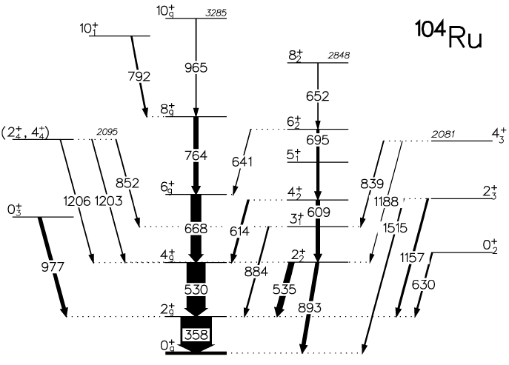
28 E2 matrix elements signs convention: stretched E2 within the band positive
Nuclear Physics A 766 (2006) 25–51
J. Srebrny, T. Czosnyka, Ch. Droste, S.G. Rohozinski,L. Próchniak, K. Zajac, K. Pomorski,
D. Cline, C.Y. Wu, A. Bäcklin, L. Hasselgren , R.M. Diamond , D. Habs, H.J. Körner,
F.S. Stephens, C. Baktash, R.P. Kostecki

Slide 6
+ +
+
+ +
+ +
+ + +
+
+ + +
+
28 E2 matrix elements signs convention: stretched E2 within the band positive
Nuclear Physics A 766 (2006) 25–51
J. Srebrny, T. Czosnyka, Ch. Droste, S.G. Rohozinski,L. Próchniak, K. Zajac, K. Pomorski,
D. Cline, C.Y. Wu, A. Bäcklin, L. Hasselgren , R.M. Diamond , D. Habs, H.J. Körner,
F.S. Stephens, C. Baktash, R.P. Kostecki

Slide 7
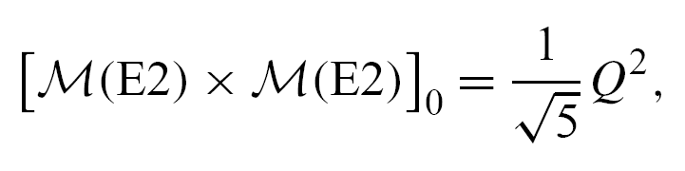
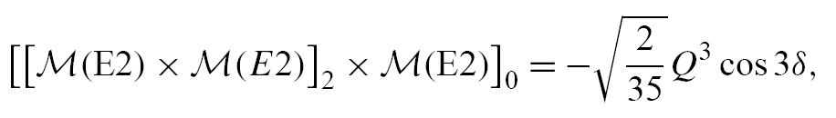
The two basic quadrupole invariants are formed of the quadrupole operator tensorM(E2) in the following way
- where [··· × ···]L stands for the vector coupling to angular momentum L.
- invariants are denoted here as Q² and Q³ cos 3δ,
in order to have a correspondence with collective coordinates,
< Q² > is an overall E2 quadrupole deformation
< cos 3δ > is E2 triaxiality
since the components of M(E2,µ) with different µ’s commute with each
other the expectation values of the E2 invariants can be related to the
reduced E2 matrix elements by making intermediate state expansions:
Σ I R > < R I = 1

Slide 8
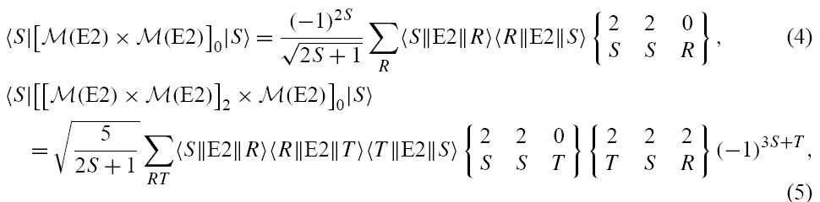
since the components of M (E2,µ) with different µ’s commute with each other the expectation values of the E2 invariants can be related to the reduced matrix elements by making intermediate state expansions:
- S denotes state S and at the same time the spin of state S alone;
R and T denotes intermediate states and their spins;
- having the experimental values of the reduced E2 matrix elements,
the expectation values of the basic quadrupole invariants
<S|Q²|S> and <S|Q³cos3δ IS> for a given state S
can be extracted from the experimental data.

Slide 10
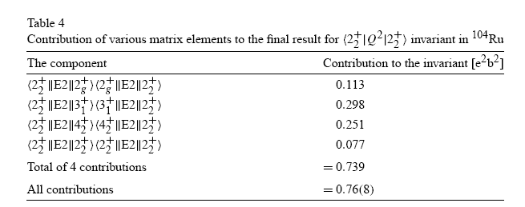
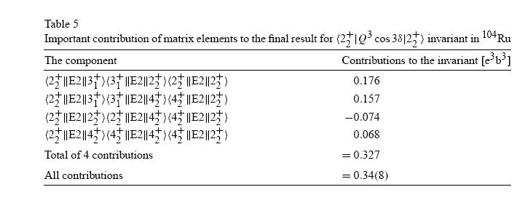

Slide 11
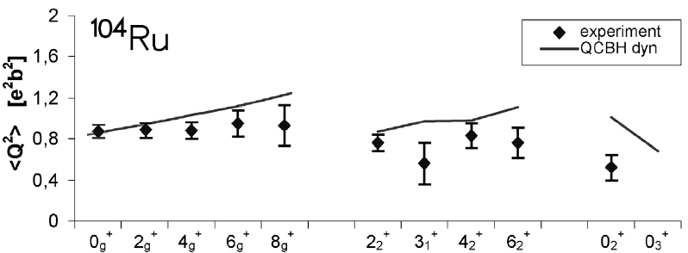
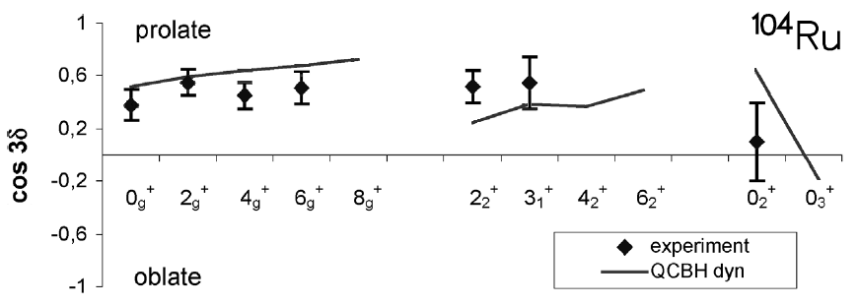
β ≈ 0.28 ≈ 0.26 ≈ 0.21
approximation:
< Q³ cos3δ > = < Q² >^{3/2} < cos3δ >
ɤ ≈ 24º ≈ 22º ≈ 30º

Slide 12
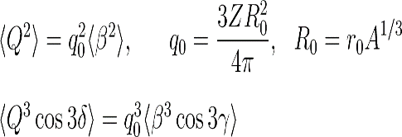
approximation:
< Q³ cos3δ > = < Q² >^{3/2} < cos3δ >
β ≈ 0.28 ≈ 0.26 ≈ 0.21
r₀ = 1.2 fm
ɤ ≈ 24º ≈ 22º ≈ 30º
The same way we can get theoretical model evaluation of our invariants: or directly or by E2 matrix elements

Slide 13
SUMMARY
1. Remember to define signs convention before starting GOSIA minimilisation
2. Having set of E2 matrix elements you can calculate invariants by SUM RULES.
Remember to check completeness of your summations.
Can be supported by model evaluations.
You can easily translate your expectation values of Q2 and Q3cos3δ
to expectation value of standard deformation parameters ß and ɤ
When compare experimental to theoretical matrix elements calculations remember
to correlate sign convention. Not needed when we compare invariants.

